Slide 1

EVER HEALTH TECHNOLOGY PLAN
Presented by: Eagle Consulting

Slide 2
EAGLE CONSULTING About Us
IT Consultancy and contracting agency for over 20 years
Founded in 1995
Goal of assisting businesses in staying up to date with the technological world around them
Acts as “Middle Man” for bringing close and personalized technology services to businesses in need

Slide 3
EAGLE CONSULTING Mission
To stay up to date on current IT developments so that we may provide the most effective solution for your specific business needs
Aim to provide a fast, efficient, and most importantly effective IT answers
Save you time and money
Have a positive effect on the clientele you closely interact with

Slide 4
EAGLE CONSULTING Vision
Facilitate an ever increasing amount of information technology solutions
Our desire is to constantly learn and develop new techniques
Aim is to be the best at understanding what makes your company special to provide the best information technology solution for you

Slide 5
EVER HEALTH About Them
A chain of fitness centers operating nationwide 24/7
In 1973 two retired coaches, Henry Truman and Michael Hatch opened the first center in Columbus, Ohio
Prides itself not only on equipment and technology, but also an amazing atmosphere, a tradition of welcome, and unique experience found nowhere else
Their corporate location currently operates out of Columbus, Ohio

Slide 6
EVER HEALTH Mission
Goal is to provide an environment that promotes accessibility to fitness equipment and knowledge to anyone that needs it
Aims to give you the tools necessary to start and maintain a healthy lifestyle
Maintaining a comfortable and welcoming experience

Slide 7
EVER HEALTH ORGANIZATIONAL CHART
Jason Zander President & CEO
Lawrie Gaffney CFO
Patrick lliott VP Finance
Lola Jacobsen VP Accounting
Olivier Renaud Team Director
Spencer Lowe Regional Manager
Of 5 Locations
Mike Danselio Regional Manager
Of 5 Locations
Prashanth Desai Regional Manager
Of 5 Locations
Szabolcs Vajda Director of Human Resources
Jason Kozleski VP Human Resources
Pat Coleman VP Customer Svc
Gym Manager
Assistant Manager of Gym
HR representative

Slide 8
EVER HEALTH - 15 LOCATIONS
East Coast
Philadelphia, PA
Arlington, VA
Midwest
Cincinnati, OH
Detroit, MI
Columbus, OH
Milwaukee, WI Chicago, IL
Dallas, TX
Houston, TX
Tucson, AZ
West Coast
Albuquerque, NM
Los Angeles, CA
San Francisco, CA
Denver, CO
Las Vegas, NV

Slide 9
THE PROBLEM
Ever Health website is outdated and lacks any type of client functionality
All information is stored locally
Customers must travel to the gym location to renew or cancel their membership
Major hassles that affect customer retention rate

Slide 10
THE COST
Ability to maintain and handle member information has become increasingly haphazard
Improper charges to cancelled or duplicate members cost both time and money to repair
In the past 2 years they have seen a 30% drop in customer membership renewal, resulting in a total loss of over $1,000,000
Customer satisfaction decreased 20% due to difficulties

Slide 11
THE SOLUTION
A centralized Database:
Shared across all gym locations
With all appropriate documentation
A redesigned and fully functional website:
Add functionality that allows customers to create, renew, update, or cancel their membership
Connected directly to the database

Slide 12
THE SOLUTION
A Front end Interface:
Properly documented and useable by all employees
Capable of pulling and updating information from the database
An accounting system capable of monitoring:
General Ledger
Accounts Receivable/Payable
Balance Sheet, Profit/Loss Statements

Slide 13
THE SOLUTION
Database, website, and network systems monitoring to ensure functionality
Develop and streamline system manual/training to ensure staff learn and understand the system
Cost/Benefit Analysis
Back up and Disaster Recovery plan

Slide 14
PROJECT COMPLETION
Expected completion date: December 13th, 2016
Upon Completion of this project, we expect to see:
A 50% increase in overall customer satisfaction
An 80% increase in customer retention
Potential to see increased revenue between $500,000 - $800,000
A 10% increase in Membership sign ups yearly; 2,000 new customers bringing in $200,000 annually
A 10% increase in employee efficiency

Slide 15
Project Team Roles and Responsibilities
Roney Whonshevins Project Lead
Jacob Wagner Software Developer
Adan Maxamed Software Developer
James Leahy Web Developer
Guy Banaga Network Engineer
Andrew Butts Network Engineer

Slide 16
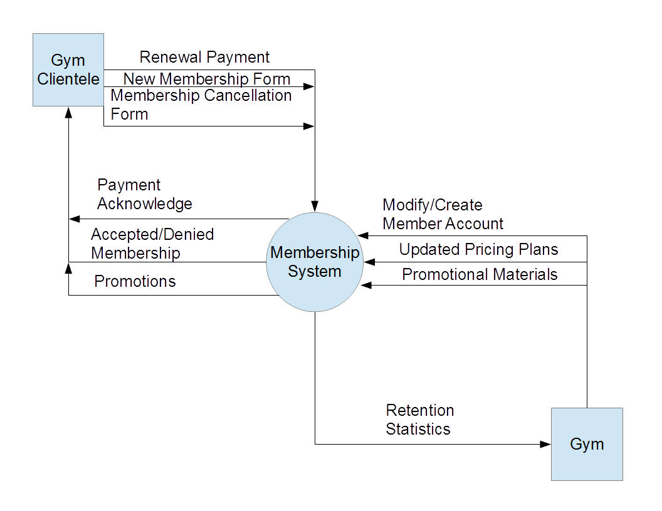
IMPLEMENTED SYSTEM
Gym Clientele
Database
Gym Location

Slide 17
PROJECT TIMELINE
Eagles Consulting
10/31/2016
2016
09/11
09/18
09/25
10/02
10/09
10/16
10/23
10/30
2016
5 days
Today
System Design
9/13/16 - 9/19/16
5 days
Creation of Financial System
9/20/16 - 9/26/16
5 days
Creation of Database Sytem
9/27/16 - 10/3/16
5 days
Excel Integration
10/4/16 - 10/10/16
5 days
Business Documents
10/11/16 - 10/17/16
5 days
Advertising Materials
10/18/16 - 10/24/16
5 days
Website Development
10/25/16 - 10/31/16

Slide 18
5 days
Report Creation
11/1/16 - 11/7/16
5 days
System Testing
11/8/16 - 11/14/16
5 days
Training
11/15/16 - 11/21/16
5 days
System Development Part 1
11/22/16 - 11/28/16
5 days
System Development Part 2
11/29/16 - 12/5/16
5 days
System Development Part 3
12/6/16 - 12/12/16
1 day
Presentation
12/13/16
Eagles Consulting
12/12/2016
2016
10/30
11/06
11/13
11/20
11/27
12/04
12/11
2016
Today

Slide 19
EVER HEALTH INTERVIEW SCHEDULE
GYM CEO – Jason Zander
Location: CEO’s Office
Time: Scheduled Appointment
Questions:
How do you feel your operation is running as of now? What parts of that do you think could be fixed with a new information system?
What statement would you like this newly implemented system to make?
What are your top priorities when it comes to the average member?
What information would you like the new system to compile?
What would the ideal situation of your business look like after the system has been implemented?

Slide 20
EVER HEALTH INTERVIEW SCHEDULE
GYM MANAGERS – most profitable/least profitable locations
Location: Local Gym Offices
Time: Scheduled Day Appointment
Questions:
What day to day problems do you experience?
What are the most common complaints that you experience?
How do you feel your operation is running as of now? What parts of that do you think could be fixed with a new information system?
What would the ideal, day to day situation of your business look like after the system has been implemented?

Slide 21
EVER HEALTH INTERVIEW SCHEDULE
GYM MEMBERS – anonymous survey
Location: N/A
Time: N/A
Questions:
What do you feel that your gym handles well?
What are the areas that the gym is lacking in?
Would you prefer to register, renew, or cancel your membership online?
What improvements would you like to see with the website?
What information would you like available to you?

Slide 22
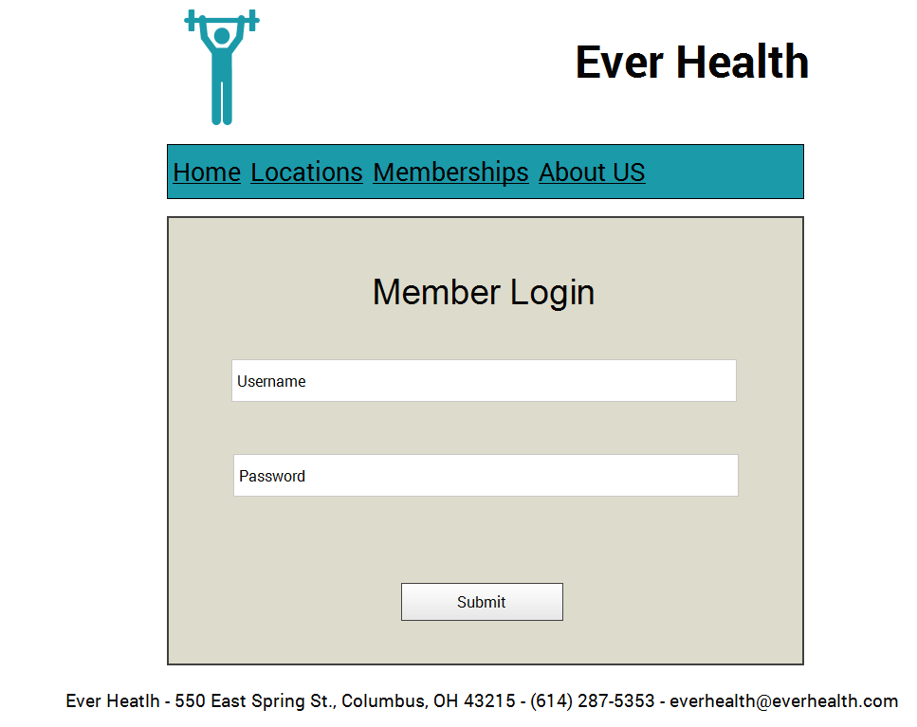
Member Login

Slide 23
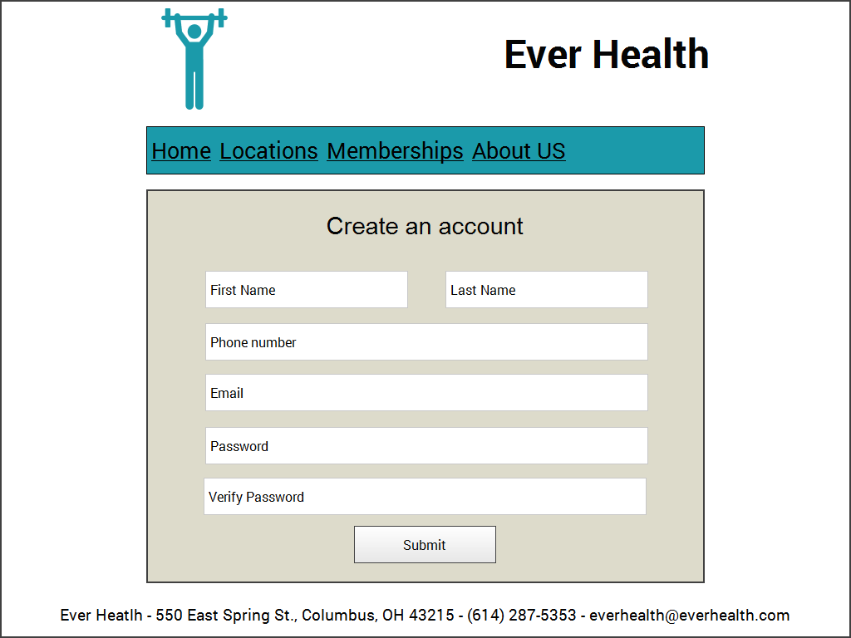
Create Account

Slide 24
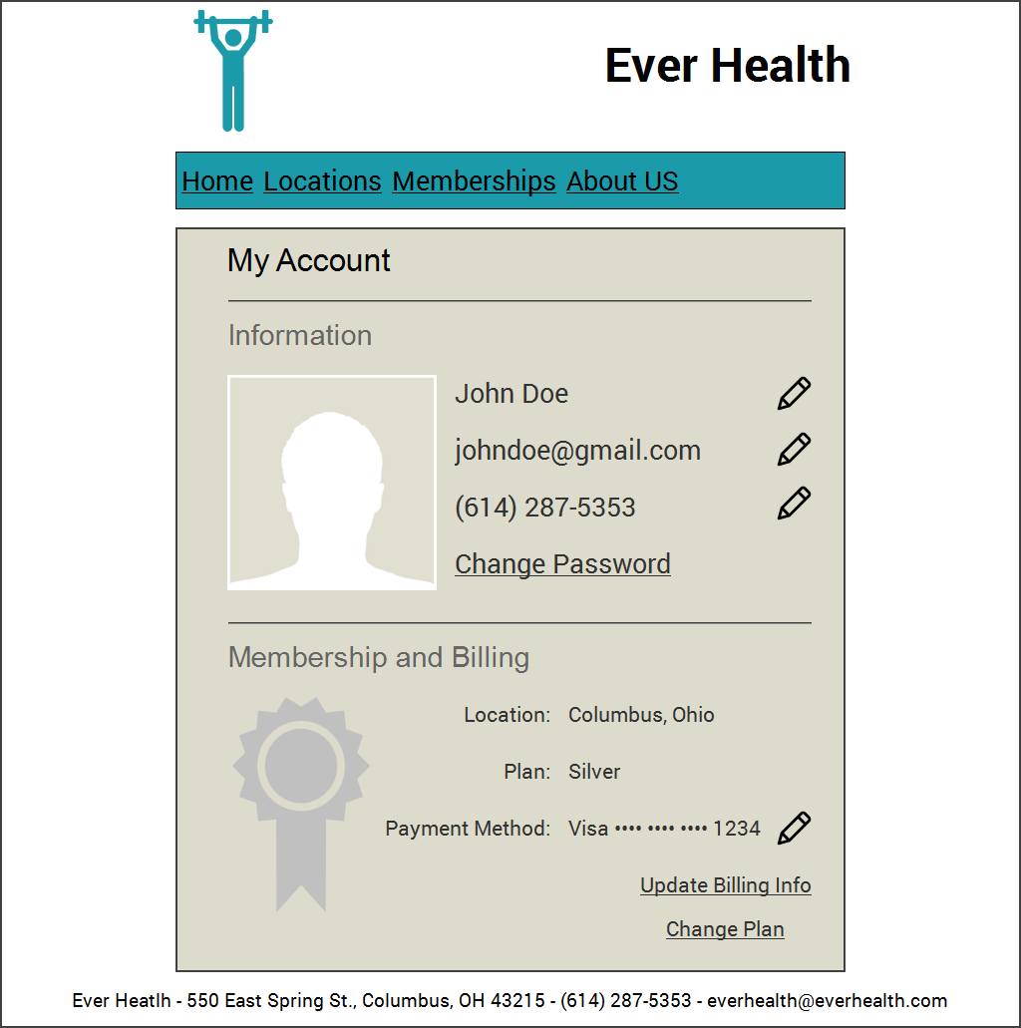
Member Landing Page

Slide 25
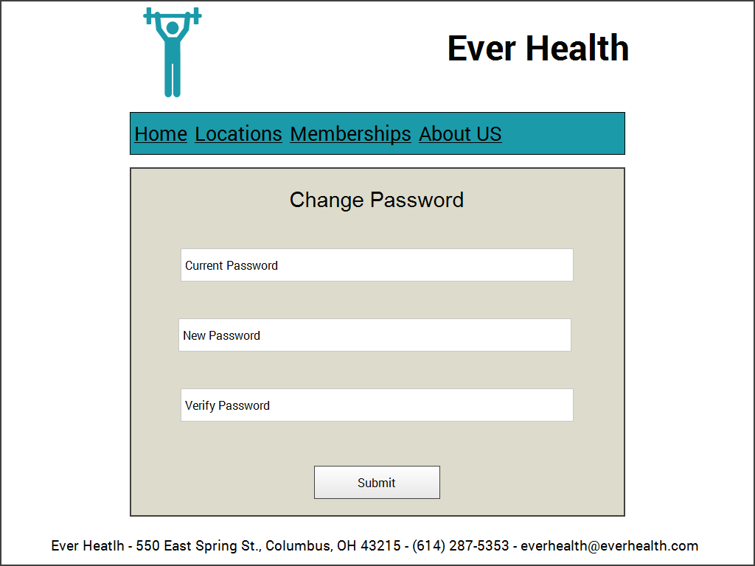
Change Password

Slide 26
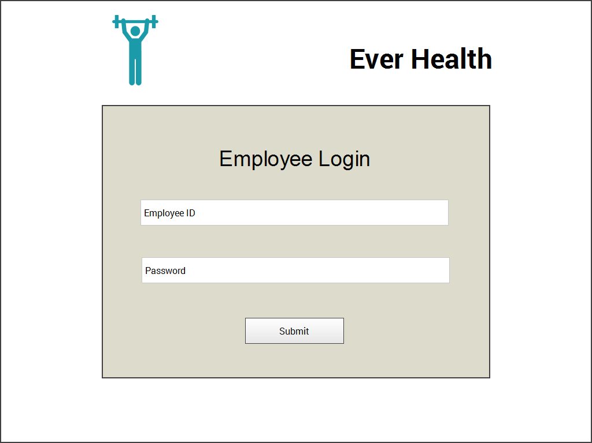
Employee Login

Slide 27
Thank You!

